Slide 1
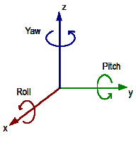
y
Roll
Pitch
Yaw
z
x

